Slide 1
GYM TRAINER AND PROGRESS TRACKER APPLICATION
Name: Krishna Prajvin
Class: III-CSE-’A’
Reg No:727822TUCS061
Team No: 13

Slide 2
OBJECTIVE
.
In today's digital age, fitness enthusiasts of all levels are increasingly turning to electronic devices to track their workouts and monitor their progress. This trend necessitates the adaptation of fitness resources to digital formats. Our project aims to meet this need by developing a comprehensive gym tracking application that not only replicates the depth and effectiveness of traditional gym sessions but also incorporates interactive elements to enhance the fitness experience.
The development of this gym tracking application involves several critical stages, including requirement analysis, design, implementation, and testing. Each stage is essential in ensuring that the final product is both user-friendly and effective in helping users achieve their fitness goals.
Our goal is to create an application that is intuitive for users of all fitness levels, yet robust and scalable enough to accommodate a wide range of workout plans and interactive features we plan to include.
This project seeks to provide a dynamic and engaging fitness environment, making quality training and progress tracking accessible to all in the digital era.

Slide 3
COMPONENTS
HOME PAGE
The gym and fitness home page is designed to create an engaging and user-friendly experience.
With its interactive user interface, gym enthusiasts can find it easy to track their progress.
This design not only enhances the user experience but also encourages gym sharks to return to the website more often to track their progress.

Slide 4
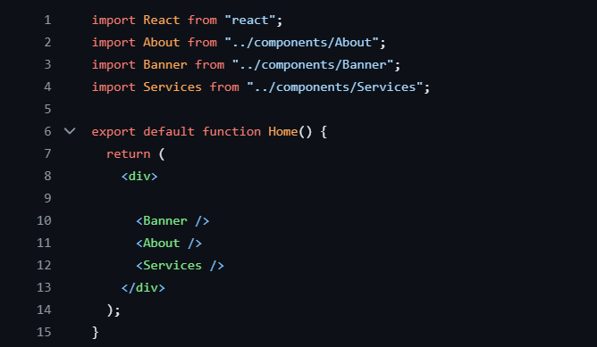
SAMPLE CODE

Slide 5
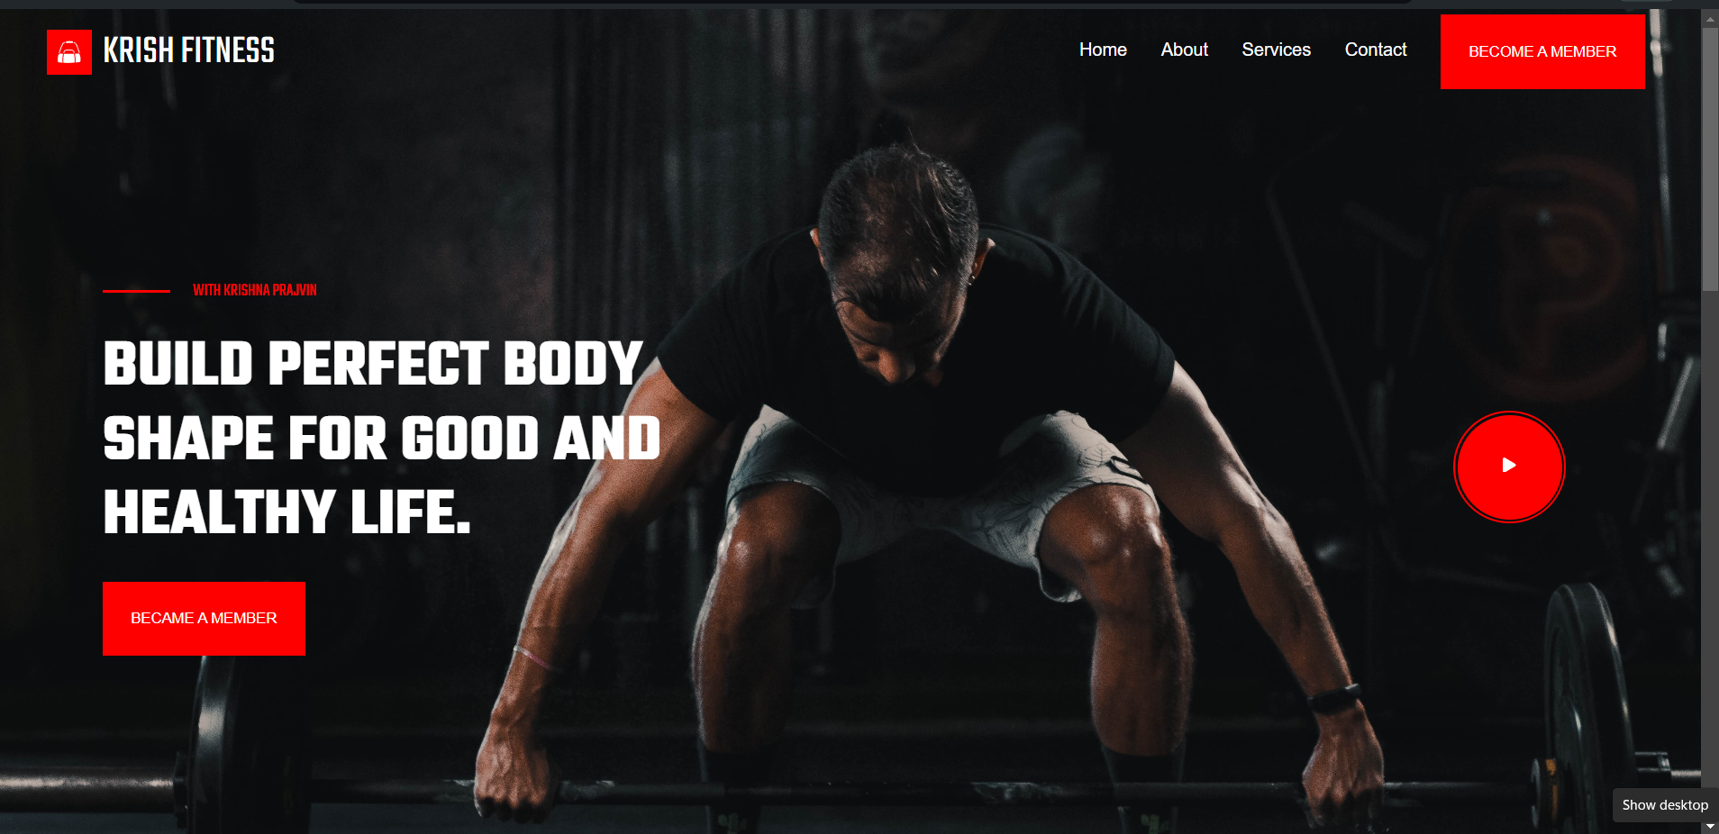
SAMPLE OUTPUT

Slide 6
SIGNIN PAGE
The signin page not only ensures secure access but also enhances user experience by maintaining the engaging and user-friendly design seen throughout the gym website.
It serves as a bridge to the personalized and comprehensive experience that awaits on the home page.
The signin page is a crucial gateway for returning users to access their personalized fitness tracking experience.

Slide 7
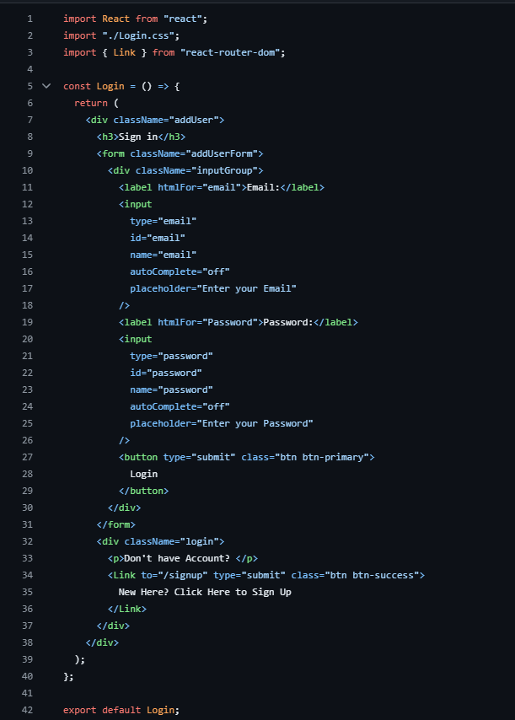
SAMPLE CODE

Slide 8

SAMPLE OUTPUT

Slide 9
REGISTER PAGE
This content emphasizes the benefits and features of registering on Gym and Fitness tracking application, encouraging users to join the community and enhance their fitness experience.
This content emphasizes the benefits and features of registering on the gym app, encouraging users to join the community and enhance their gym experience.
Users can create accounts and build profiles to manage their personal information, view order history, and save their preferences.

Slide 10
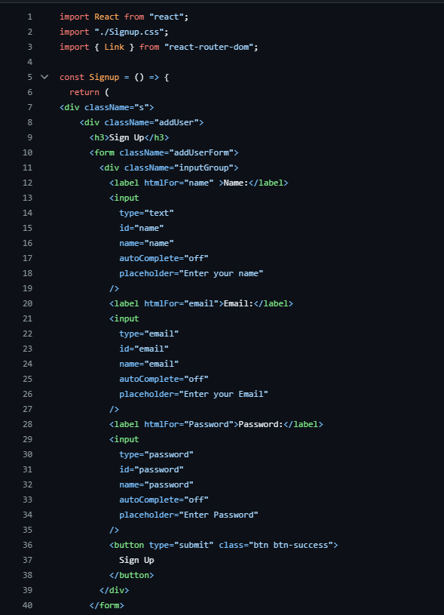
SAMPLE CODE

Slide 11
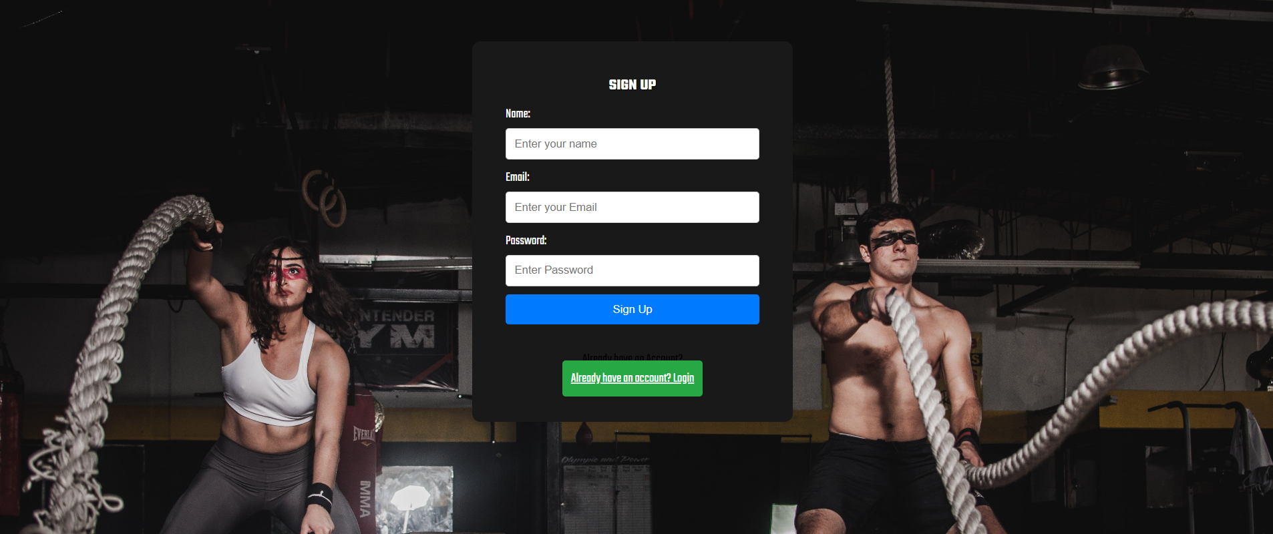
SAMPLE OUTPUT

Slide 12
DASHBOARD
The user and admin dashboard allows users to manage their personal profiles, keeping track of their fitness activities.
This personalized space enables users to save their progress, ensuring that they can pick up right where they left off in their fitness journey.

Slide 13
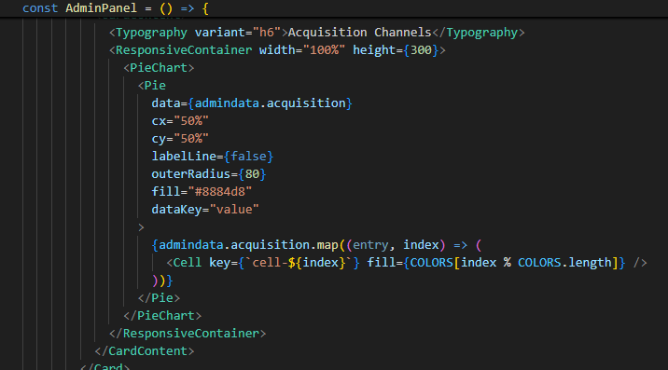
SAMPLE CODE

Slide 14
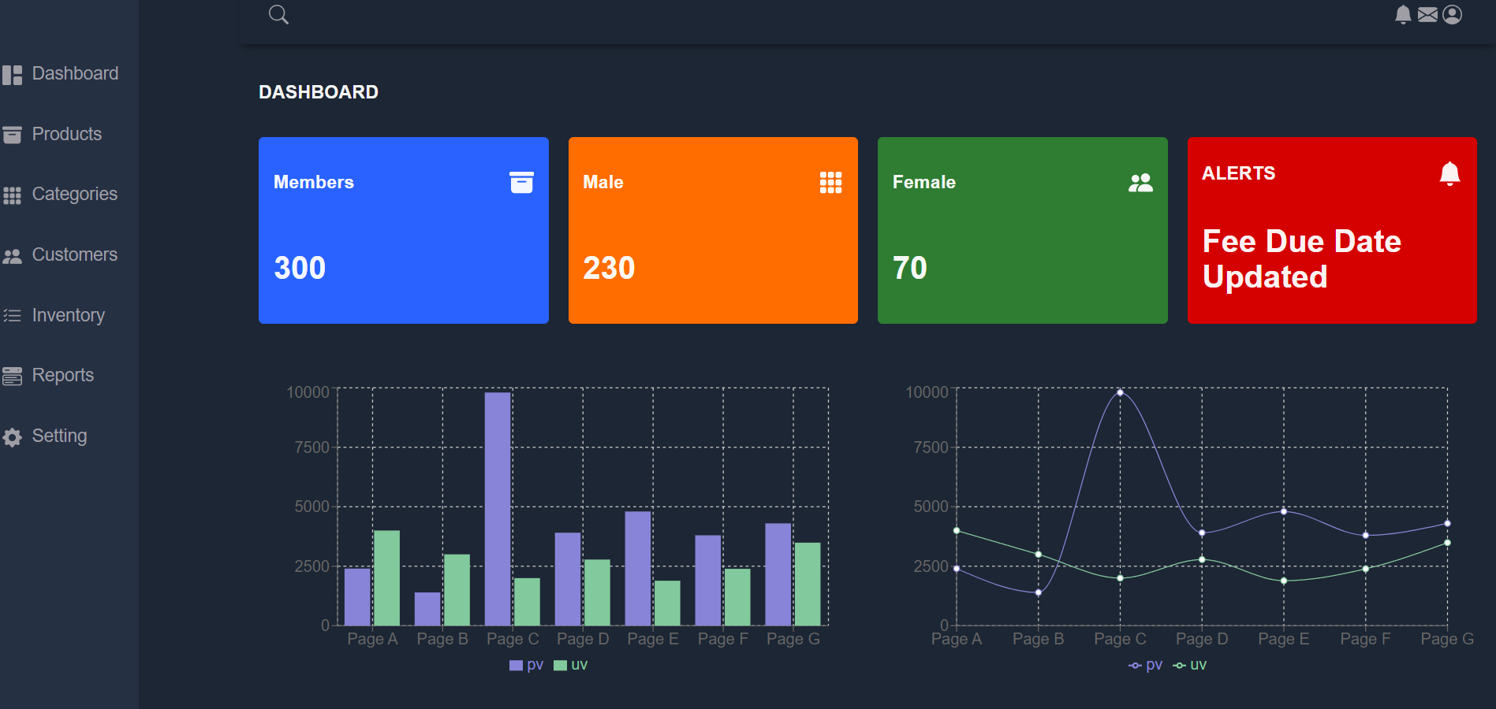
SAMPLE OUTPUT

Slide 15
Implementing Backend REST API with Spring Boot, MySQL, and Postman

Slide 16
What is a REST API?
Definition: A REST (Representational State Transfer) API is a set of rules that allows for interaction with web services. REST uses standard HTTP methods like GET, POST, PUT, and DELETE for operations.
REST APIs are widely used in web applications to enable communication between the client (frontend) and the server (backend).

Slide 17
Tools and Technologies :
Spring Boot: - Simplifies the bootstrapping and development of new Spring applications. - Provides a range of non-functional features common to large classes of projects (such as embedded servers).
MySQL: - A popular relational database management system. - Used to store and manage application data.
Postman: - An API testing tool. - Used to send requests and view responses from the API.

Slide 18
Architecture

Slide 19
Implementation
Spring Boot:
Project setup with Spring Initializer.
Creating REST controllers.
Dependency Injection.
MySQL:
Setting up the database.
Configuring database connection in Spring Boot.
Postman:
Creating requests to test endpoints.
Analyzing responses.

Slide 20
CONCLUSION
Overall, the Gym and Fitness Tracking project serves as a testament to the capabilities of React in building scalable, secure, and feature-rich web applications.
the development of an online platform dedicated to gym tracking offers a transformative solution to the increasing demand for accessible, efficient, and personalized fitness management in today's health-conscious society.
By utilizing technology to streamline workout planning, enhance motivation, and provide personalized insights, it promises to usher in a new era of effortless and enjoyable fitness management. This ensures that every workout is a resounding success and a vital step towards achieving optimal health and well-being.

